Slide 1

BINV3140 Spring
Cours 4
2023-2024
Gillard Xavier
Strebelle Sébastien

Slide 2

Authentification

Slide 3
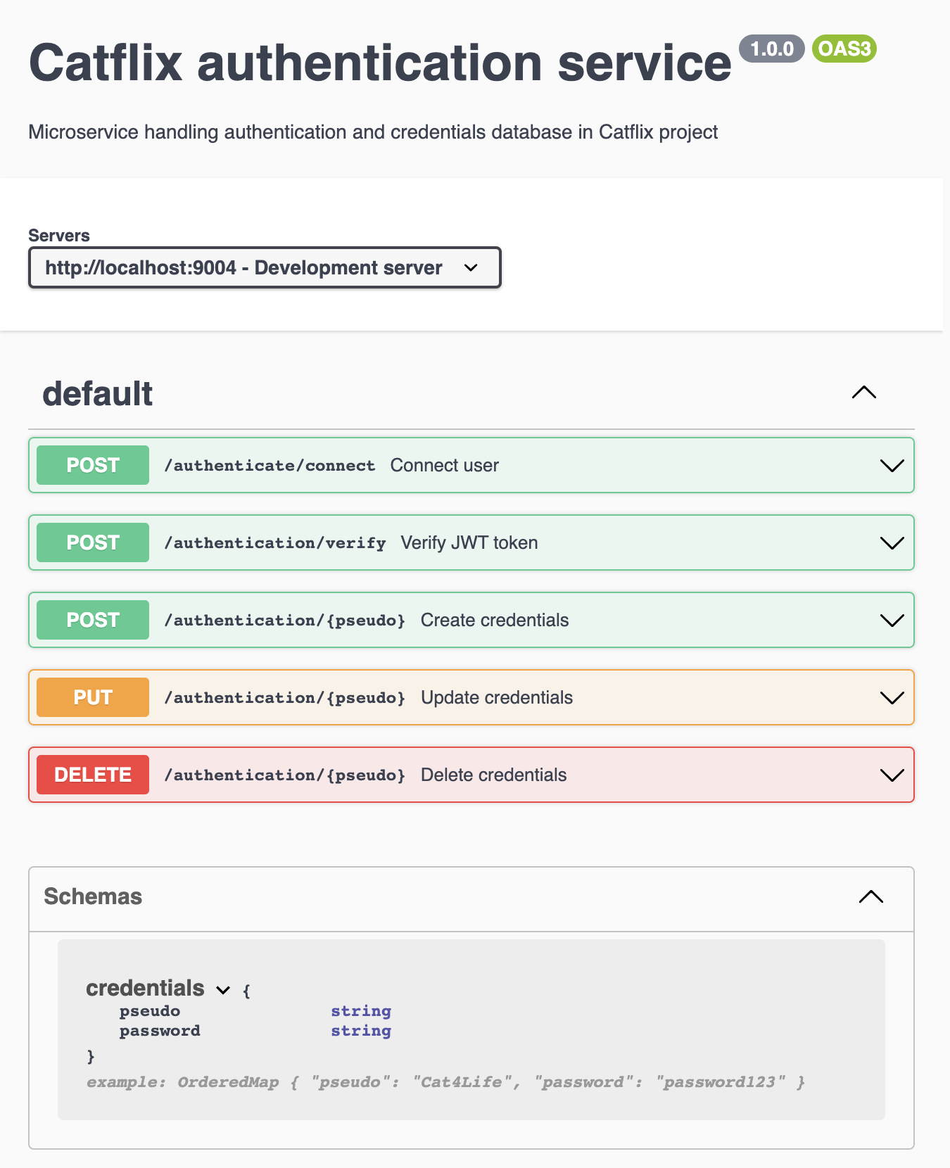
Service d’authentification
1 responsabilité = 1 service
Service pour gérer la sécurité
Isolé des autres

Slide 4
Credentials
public class UnsafeCredentials { private String pseudo; private String password; public SafeCredentials makeSafe(String hashedPassword) { return new SafeCredentials(pseudo, hashedPassword); } public boolean invalid() { return pseudo == null || pseudo.isBlank() || password == null || password.isBlank(); } }
@Entity(name = "credentials") public class SafeCredentials { @Id @Column(nullable = false) private String pseudo; @Column(name = "password", nullable = false) private String hashedPassword; }

Slide 5
JWT & BCrypt
Comme en backend java!
Pas dans spring initializer…
On édite le pom.xml
<dependency> <groupId>com.auth0</groupId> <artifactId>java-jwt</artifactId> <version>4.0.0</version> </dependency>
<dependency> <groupId>org.mindrot</groupId> <artifactId>jbcrypt</artifactId> <version>0.4</version> </dependency>

Slide 6
JWT & BCrypt
>>> AuthenticationService.java
private final AuthenticationRepository repository; private final Algorithm jwtAlgorithm; private final JWTVerifier jwtVerifier; public AuthenticationService(AuthenticationRepository repository, AuthenticationProperties properties) { this.repository = repository; this.jwtAlgorithm = Algorithm.HMAC512(properties.getSecret()); this.jwtVerifier = JWT.require(this.jwtAlgorithm).withIssuer("auth0").build(); }
public boolean createOne(UnsafeCredentials unsafeCredentials) { if (repository.existsById(unsafeCredentials.getPseudo())) return false; String hashedPassword = BCrypt.hashpw(unsafeCredentials.getPassword(), BCrypt.gensalt()); repository.save(unsafeCredentials.makeSafe(hashedPassword)); return true; }

Slide 7
JWT & BCrypt
>>> AuthenticationService.java
public String connect(UnsafeCredentials unsafeCredentials) { SafeCredentials safeCredentials = repository.findById(unsafeCredentials.getPseudo()).orElse(null); if (safeCredentials == null) return null; if (!BCrypt.checkpw(unsafeCredentials.getPassword(), safeCredentials.getHashedPassword())) return null; return JWT.create().withIssuer("auth0").withClaim("pseudo", safeCredentials.getPseudo()).sign(jwtAlgorithm); }
public String verify(String token) { try { String pseudo = jwtVerifier.verify(token).getClaim("pseudo").asString(); if (!repository.existsById(pseudo)) return null; return pseudo; } catch (JWTVerificationException e) { return null; } }

Slide 8
Custom properties
Ajout de nos propres configurations dans les propriétés de l’application
Dans ce projet : cacher le secret de BCrypt
@Getter @Setter @Configuration @ConfigurationProperties(prefix = "be.vinci.ipl.catflix.authentication") public class AuthenticationProperties { private String secret; }

Slide 9
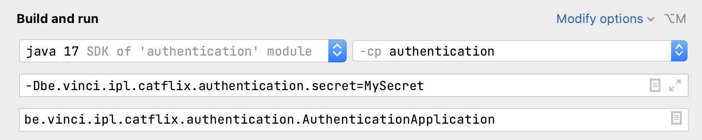
Custom properties
Configuration dans le application.properties
Secrets sur le git…
spring.application.name=authentication server.port=9004 eureka.client.service-url.defaultZone=http://localhost:9000/eureka # be.vinci.ipl.catflix.authentication.secret="Change me in service launch configuration"
Dans la config de lancement du service
Services > Edit configuration > Modify options > Add VM options
Ne pas push le fichier .idea/workspace.xml

Slide 10
Gateway

Slide 11
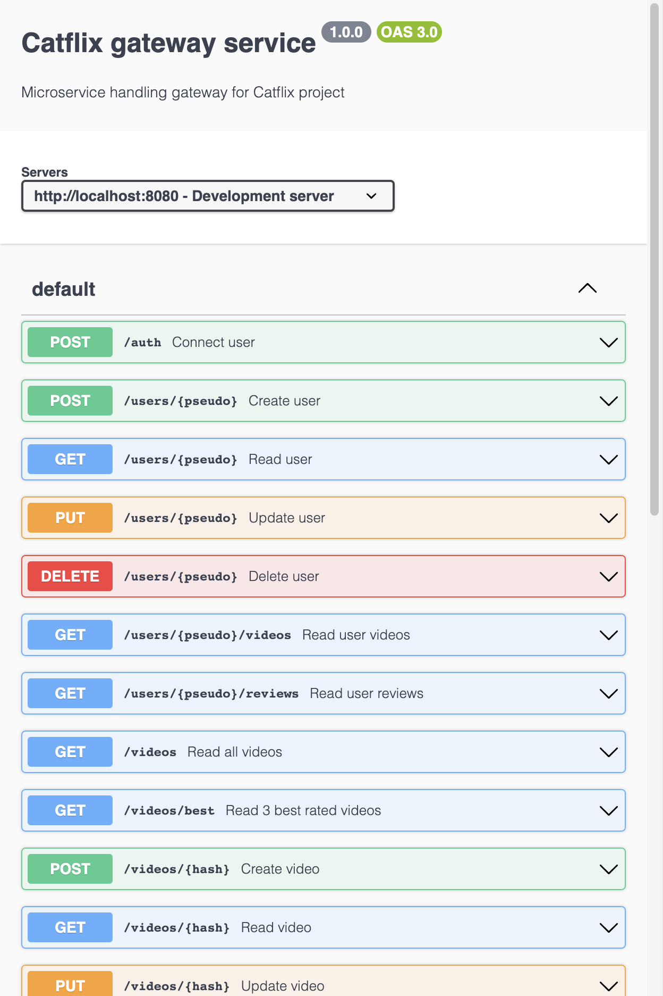
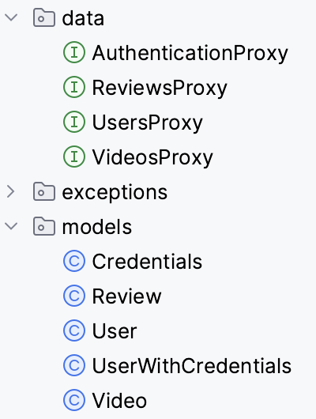
Gateway service
Point d’accès unique de l’application
Orchestre les accès aux services
Vérification d’authentification
Proxy avec tous les autres services

Slide 12
Create user
>>> UsersProxy.java
@PostMapping("/users/{pseudo}") void createUser(@PathVariable String pseudo, @RequestBody User user);
>>> AuthenticationProxy.java
@PostMapping("/authentication/{pseudo}") void createCredentials(@PathVariable String pseudo, @RequestBody Credentials credentials);
>>> GatewayController.java
@PostMapping("/users/{pseudo}")
public ResponseEntity<Void> createUser(@PathVariable String pseudo, @RequestBody UserWithCredentials user) { if (!Objects.equals(user.getPseudo(), pseudo)) return new ResponseEntity<>(HttpStatus.BAD_REQUEST); try { service.createUser(user); return new ResponseEntity<>(HttpStatus.CREATED); } catch (BadRequestException e) { return new ResponseEntity<>(HttpStatus.BAD_REQUEST); } catch (ConflictException e) { return new ResponseEntity<>(HttpStatus.CONFLICT); } }

Slide 13
Create user
>>> GatewayService.java
public void createUser(UserWithCredentials user) throws BadRequestException, ConflictException { try { usersProxy.createUser(user.getPseudo(), user.toUser()); } catch (FeignException e) { if (e.status() == 400) throw new BadRequestException(); else if (e.status() == 409) throw new ConflictException(); else throw e; } try { authenticationProxy.createCredentials(user.getPseudo(), user.toCredentials()); } catch (FeignException e) { try { usersProxy.deleteUser(user.getPseudo()); } catch (FeignException ignored) { } if (e.status() == 400) throw new BadRequestException(); else if (e.status() == 409) throw new ConflictException(); else throw e; } }

Slide 14
Delete user
>>> GatewayService.java
public boolean deleteUser(String pseudo) { reviewsProxy.deleteReviewsFromUser(pseudo); videosProxy.deleteVideosFromAuthor(pseudo); boolean found = true; try { authenticationProxy.deleteCredentials(pseudo); } catch (FeignException e) { if (e.status() == 404) found = false; else throw e; } try { usersProxy.deleteUser(pseudo); } catch (FeignException e) { if (e.status() == 404) found = false; else throw e; } return found; }

Slide 15
Delete user
>>> GatewayController.java
@DeleteMapping("/users/{pseudo}") public ResponseEntity<Void> deleteUser(@PathVariable String pseudo, @RequestHeader("Authorization") String token) { String user = service.verify(token); if (user == null) return new ResponseEntity<>(HttpStatus.UNAUTHORIZED); else if (!Objects.equals(user, pseudo)) return new ResponseEntity<>(HttpStatus.FORBIDDEN); boolean found = service.deleteUser(pseudo); if (!found) return new ResponseEntity<>(HttpStatus.NOT_FOUND); else return new ResponseEntity<>(HttpStatus.OK); }

Slide 16
Create review
>>> GatewayService.java
public void createReview(Review review) throws BadRequestException, NotFoundException, ConflictException { try { usersProxy.readUser(review.getPseudo()); } catch (FeignException e) { if (e.status() == 404) throw new NotFoundException(); else throw e; } try { videosProxy.readVideo(review.getHash()); } catch (FeignException e) { if (e.status() == 404) throw new NotFoundException(); else throw e; } try { reviewsProxy.createReview(review.getPseudo(), review.getHash(), review); } catch (FeignException e) { if (e.status() == 400) throw new BadRequestException(); else if (e.status() == 409) throw new ConflictException(); else throw e; } }

Slide 17
Create review
>>> GatewayController.java
@PostMapping("/reviews/{pseudo}/{hash}") public ResponseEntity<Void> createReview(@PathVariable String pseudo, @PathVariable String hash, @RequestBody Review review, @RequestHeader("Authorization") String token) { if (!Objects.equals(review.getPseudo(), pseudo) || !Objects.equals(review.getHash(), hash)) { return new ResponseEntity<>(HttpStatus.BAD_REQUEST); } String user = service.verify(token); if (user == null) return new ResponseEntity<>(HttpStatus.UNAUTHORIZED); else if (!Objects.equals(review.getPseudo(), user)) return new ResponseEntity<>(HttpStatus.FORBIDDEN); try { service.createReview(review); return new ResponseEntity<>(HttpStatus.CREATED); } catch (BadRequestException e) { return new ResponseEntity<>(HttpStatus.BAD_REQUEST); } catch (NotFoundException e) { return new ResponseEntity<>(HttpStatus.NOT_FOUND); } catch (ConflictException e) { return new ResponseEntity<>(HttpStatus.CONFLICT); } }

Slide 18
Exercice

Slide 19
Exercice
Rajoutez dans votre projet Amazing un service authentication en vous basant sur le service donné sur moodle
Créez pour votre projet Amazing un service de gateway, en commençant par sa documentation

